Slide 1
Supply Chain Management
Quantitative Analysis

Slide 2
Plan of the lecture
Part I: Inventory Control Models
Part II: Stochastic Modelling

Slide 3
Part I: Topics
Economic order quantity (EOQ) model
Economic production lot-size model
Backorder model
EOQ model with discontinuity purchase price
Production and inventory control problem

Slide 4
1.0 Introduction
Inventory refers to idle goods or materials that are held
by an organization for use sometime in future.
Examples.
Raw materials, purchased parts, components, subassemblies
work-in-process, finished goods

Slide 5
Key issues:
1. What are possible costs?
  Order cost. There is a fixed cost when an order is placed.
  Holding cost. It represents the costs of carrying inventory in stock (e.g. interest on invested capital, storage, handling, depreciation, and maintenance)

Slide 6
  Purchasing cost. A discount or price break when the order quantity reaches certain level.
  Shortage cost. It is a penalty when stock is run out (e.g. lost of customers goodwill and potential loss of income).

Slide 7
2. How much should be ordered when the inventory is replenished?
More frequent orders lower inventory level or vice versa? The answer is to minimize the total cost.

Slide 8
3. When should the inventory be replenished?
There are two ways.
Periodic review. To order at a fixed time interval.
Continuous review. To order when inventory reaches a certain level.

Slide 9
Possible demand scenarios
Demand may be deterministic or probabilistic.
A deterministic demand is said to be static if the consumption rate is constant, or dynamic if the consumption rate varies from time to time.

Slide 10
A probabilistic demand is said to be stationary if the density function of the demand remains unchanged over time, or non-stationary if the density function of the demand changes over time.

Slide 11
1.1 Economic Order Quantity (EOQ) Model
Assumptions
Constant, continuous demand rate (e.g. 5units every day or 25 per week)
Replenishment orders are placed at regular time intervals; and the order quantity Q, is the same each time
Stockout is not allowed (that is: no last sales, no backorders)
Constant unit purchase cost (No purchasing discount)

Slide 12
Inventory level
Slope = -D
Q+S
S
T
Time

Slide 13

Relationship between Q, D and T:
Input in one cycle = output in one cycle
The central issue in EOQ model is to minimize the total costs which include the running cost and purchase cost. Running cost consists of the order cost and inventory holding cost.

Slide 14
Notation (assume the unit of time is year)
C= unit purchase cost (unit price)
C_{h}= annual cost of holding one unit in stock
C₀= fixed cost of placing one replenishment order (irrespective of order size)

Slide 15
Questions:
How does the total average annual cost K depend on Q and S?
What values of Q and S minimize K?
The first step is to formulate the total cost.

Slide 16
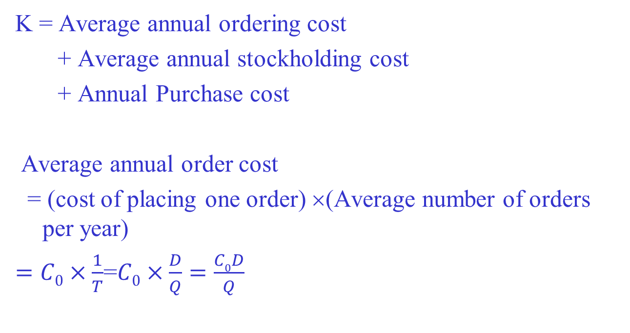

Slide 17
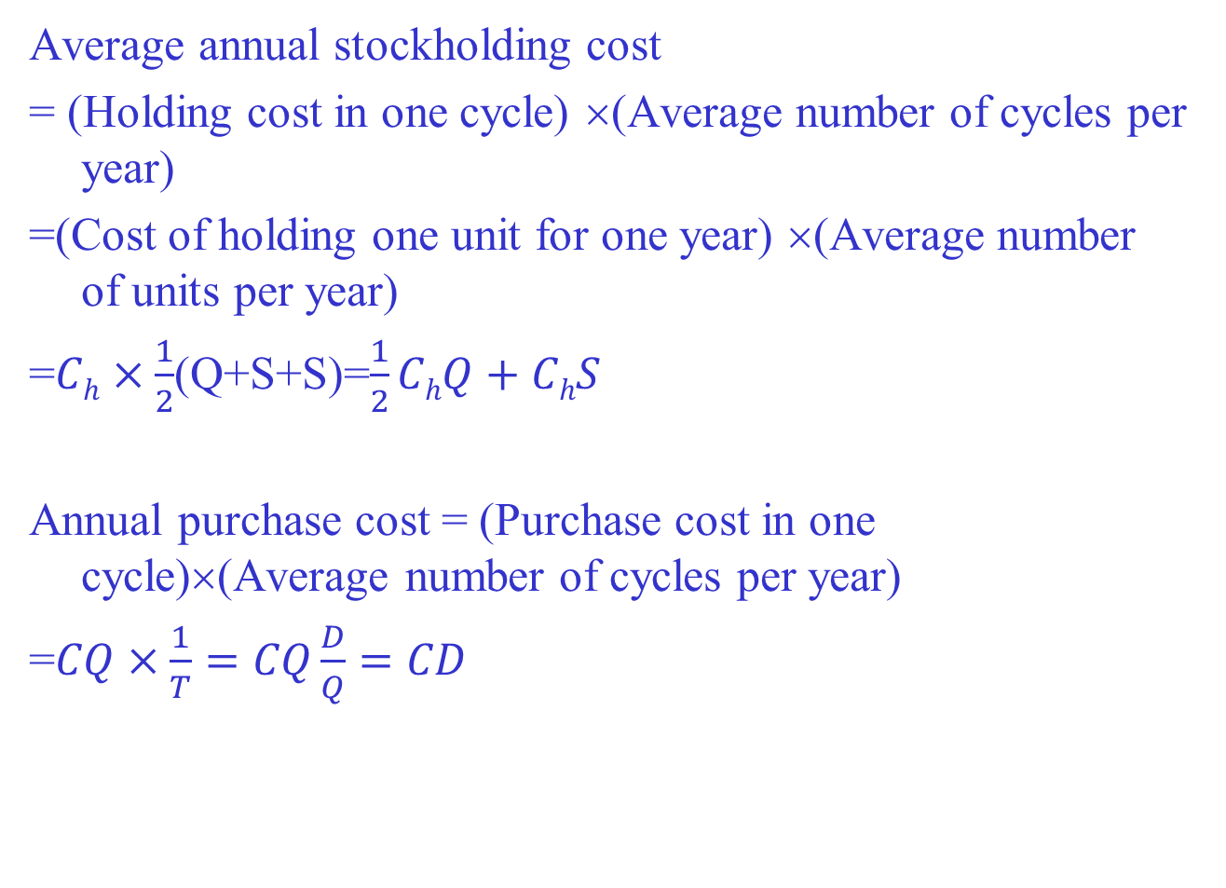

Slide 18
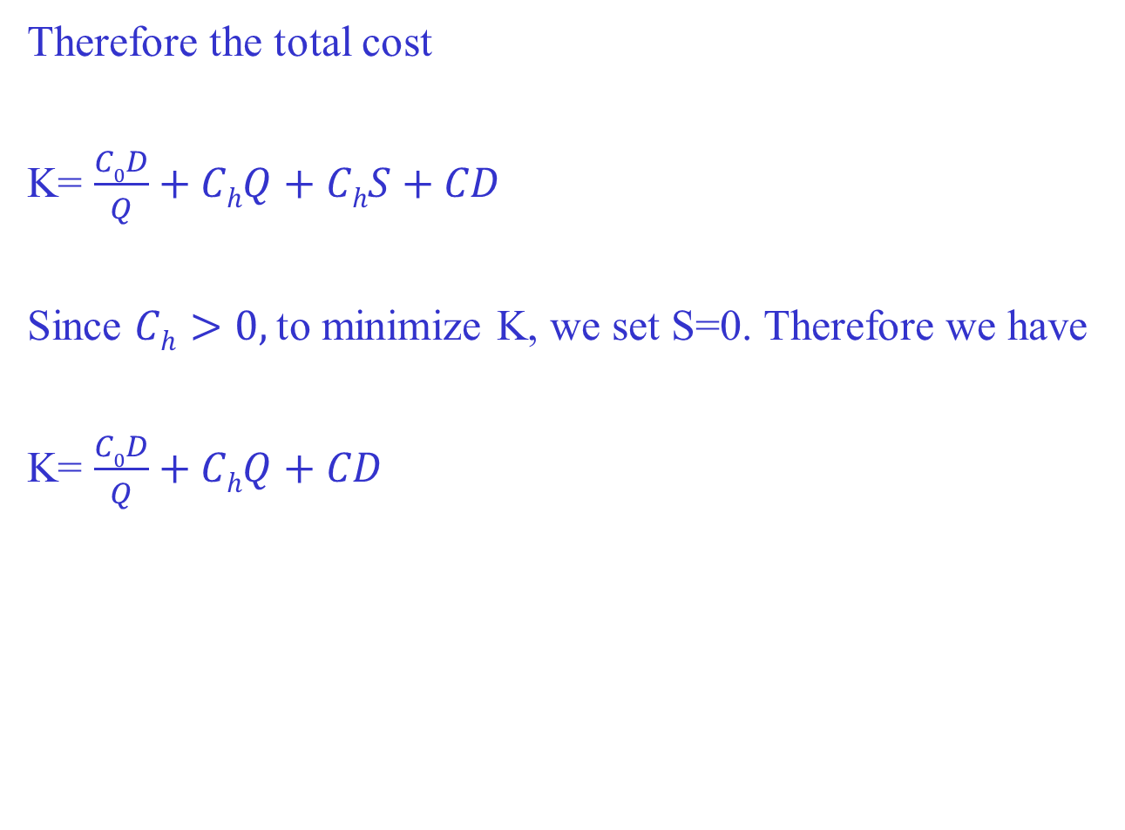

Slide 19
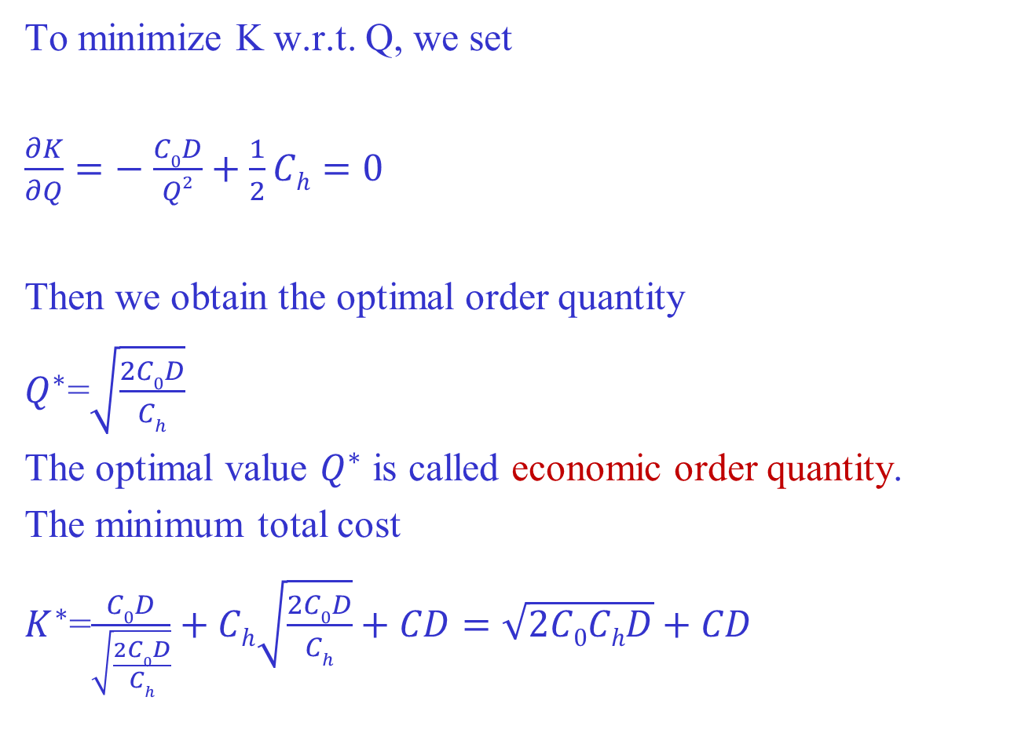

Slide 20
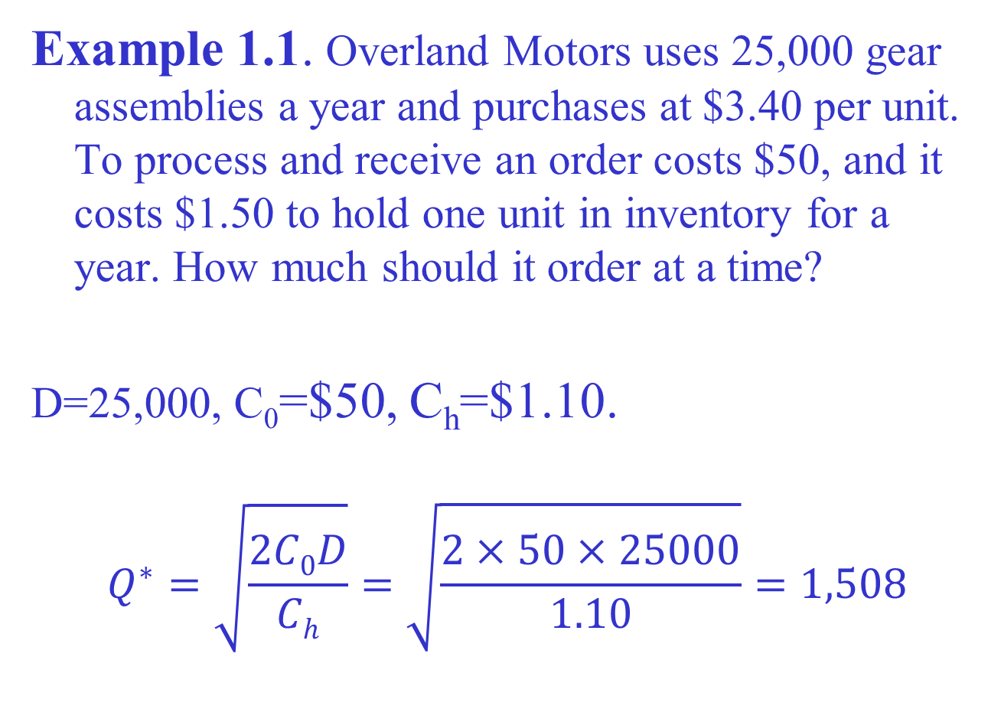
1

Slide 21
Cost
Total cost
Holding cost
Order cost
T
Q

Slide 22
When to reorder
Inventory position is defined as the amount of inventory on hand plus the amount of inventory on order.
Reorder point is the inventory position at which a new order is placed. (Therefore, the inventory position reaches minimum at the reorder point.)
Lead time is the required delivery time.
We denote it by L.
Lead time demand is the demand over the lead time.
We denote it by r.
Reorder point = lead time demand=LD

Slide 23
Inventory level
Slope = -D
Q
r
L
Time
r=LD

Slide 24
When the demand is stochastic,
Reorder point = average demand in lead time
+ safety stock
where the safety stock is calculated through the standard deviation of the lead time demand.

Slide 25
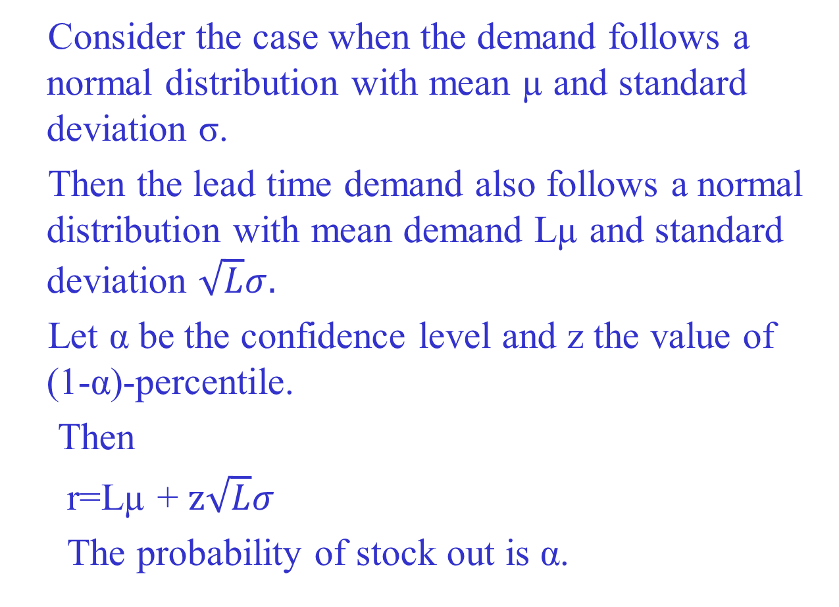

Slide 26
1.2 Economic Production Lot-Size Model (Finite Production Rate Model)
In the EOQ model, we assumed that the goods arrive in a shipment of size Q*.
In this model, we assume that goods are supplied (or produced) to inventory continuously at a constant rate over a time period (e.g. days, weeks).

Slide 27
Inventory level
Slope = P-D
Q
Slope = -D
Time
T_{p}
T_{d}

Slide 28
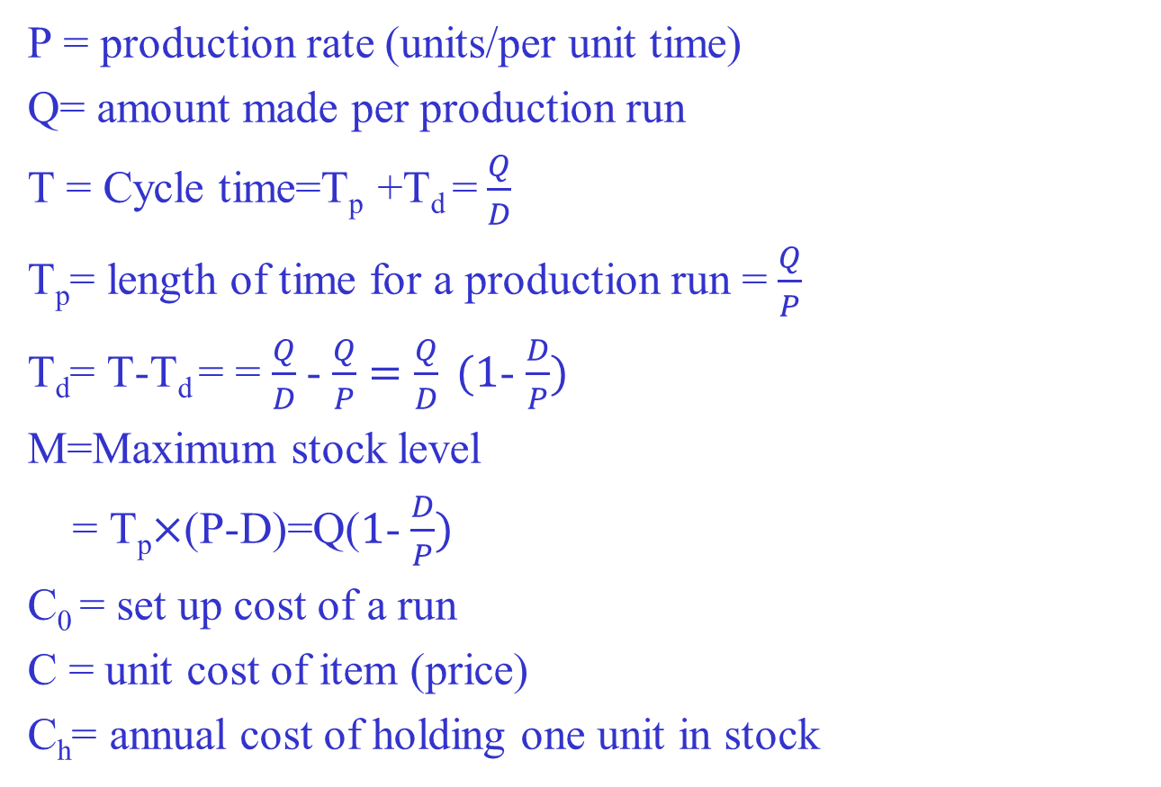

Slide 29
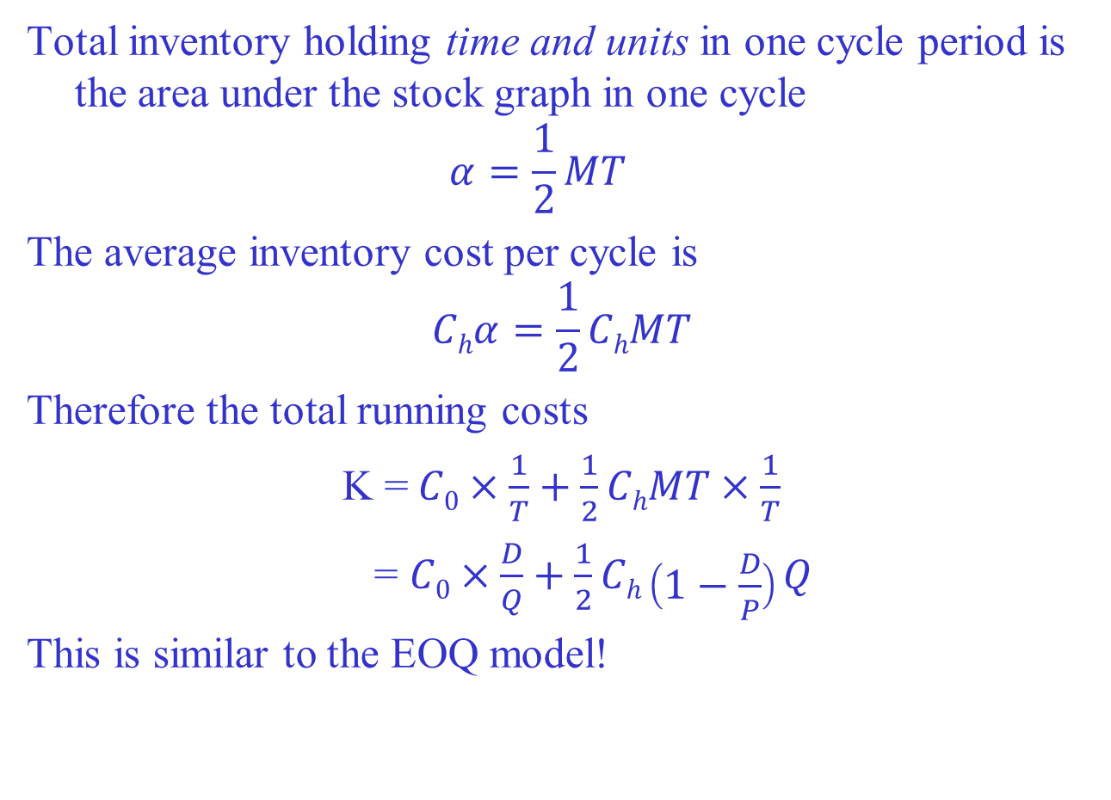

Slide 30
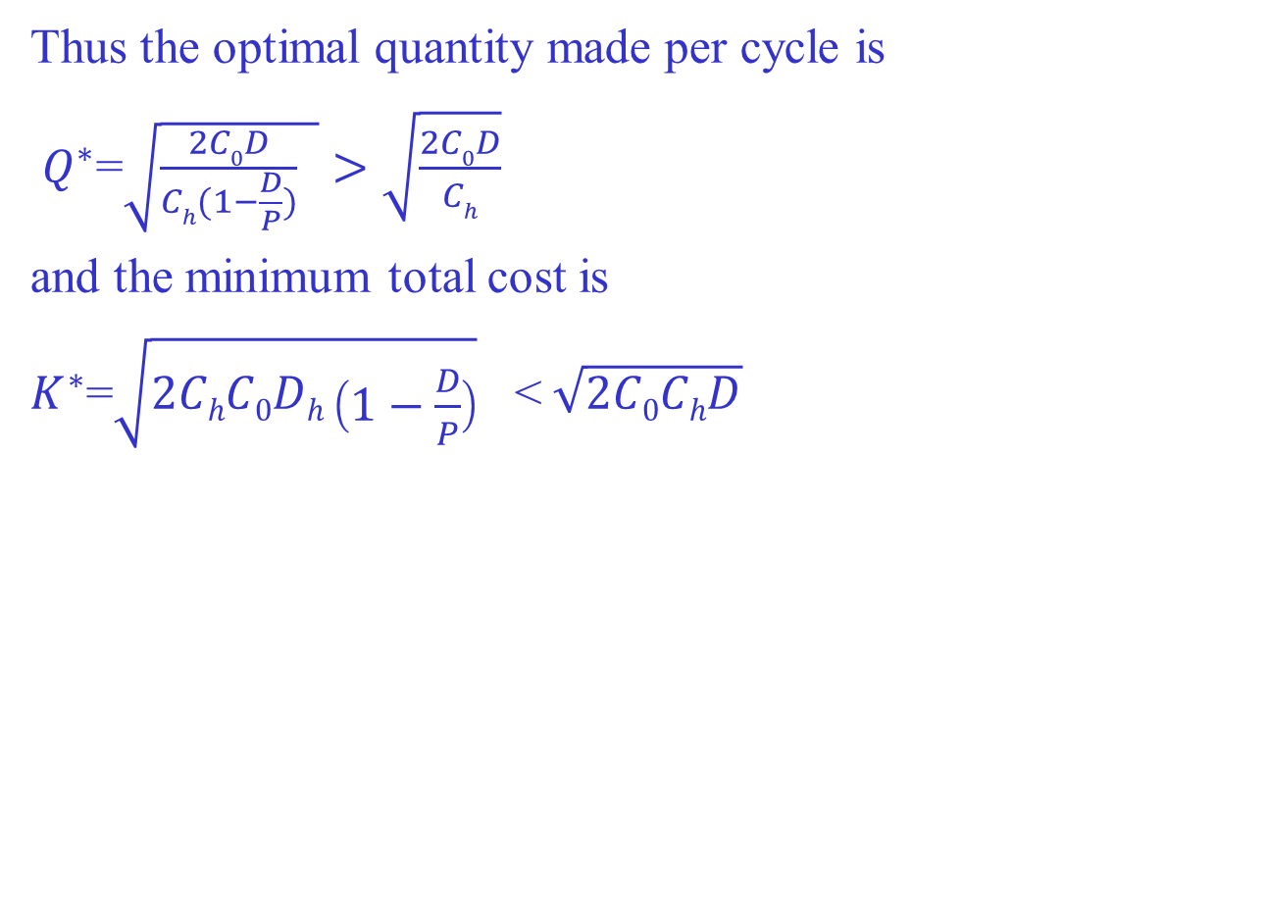

Slide 31
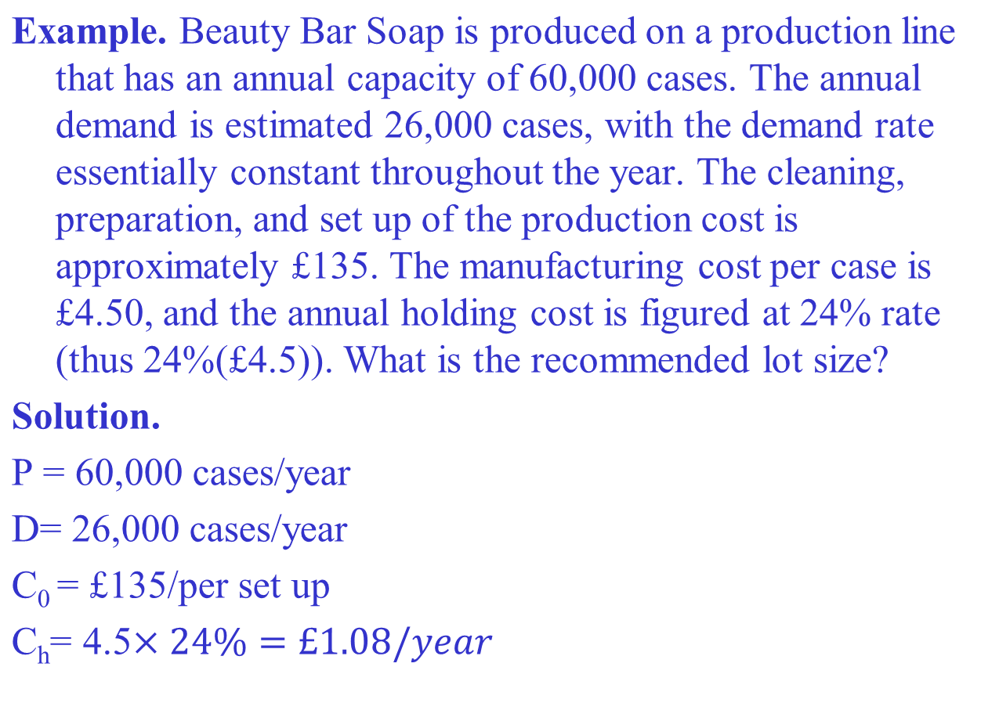

Slide 32
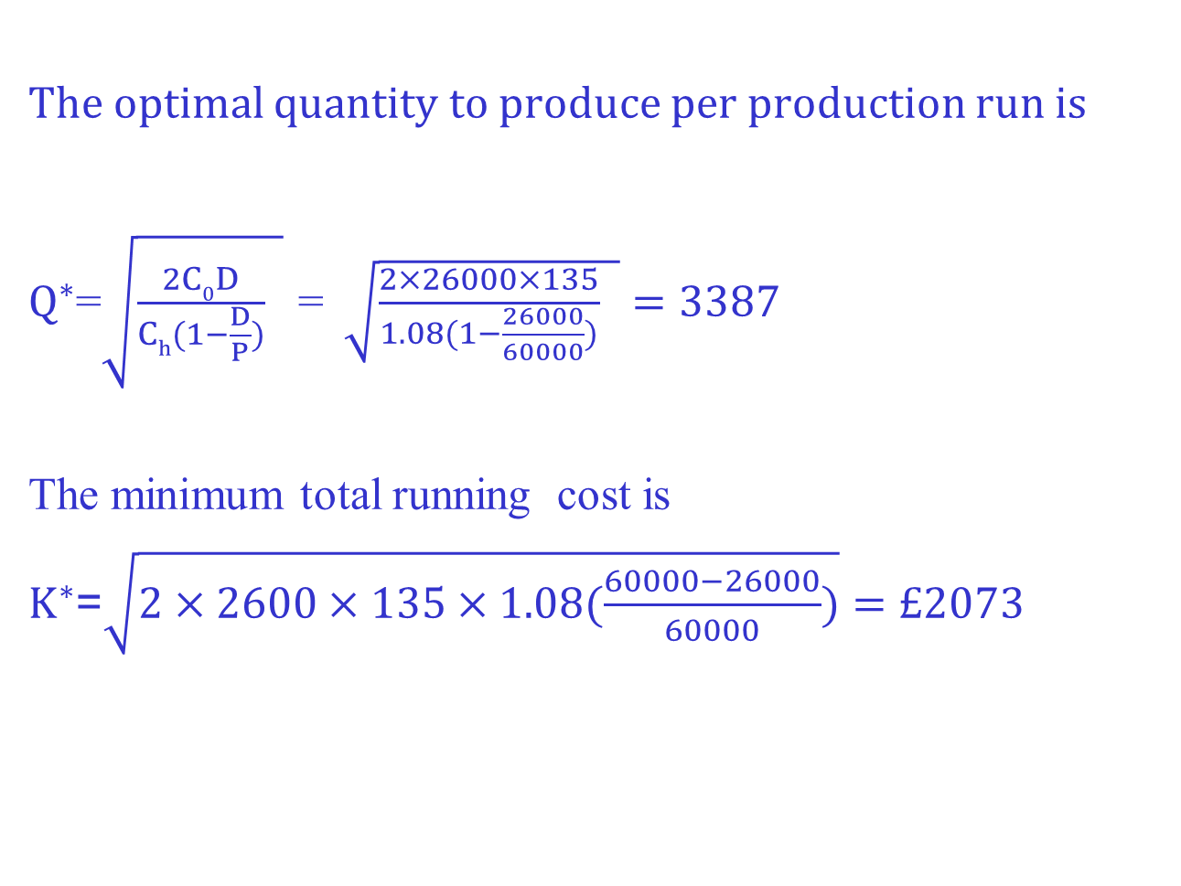

Slide 33
1.3 An Inventory Model with Planed Shortages--Backorders
A shortage or stockout is a case when demand cannot be satisfied (supplied). In many situations, stockouts are not desirable, however, in some cases, it may be desirable, from economic point of view, to plan for and allow shortages. In practice, these situations are most commonly found where the value of inventory per unit is high and hence the holding cost is high, e.g. new car dealers.

Slide 34
Inventory level
Slope = -D
Q-B
T₁
T₂
B
T

Slide 35
Characteristics:
If B backorders exist when a new shipment of size Q arrives, the B backorders are shipped to the appropriate customers. Therefore the maximum inventory level is Q-B.
The inventory cycle of T is divided into two distinct phases: T₁ when inventory is on hand and orders are filled when they occurs;T₂ when stockout occur and all new orders are placed on backorder.

Slide 36
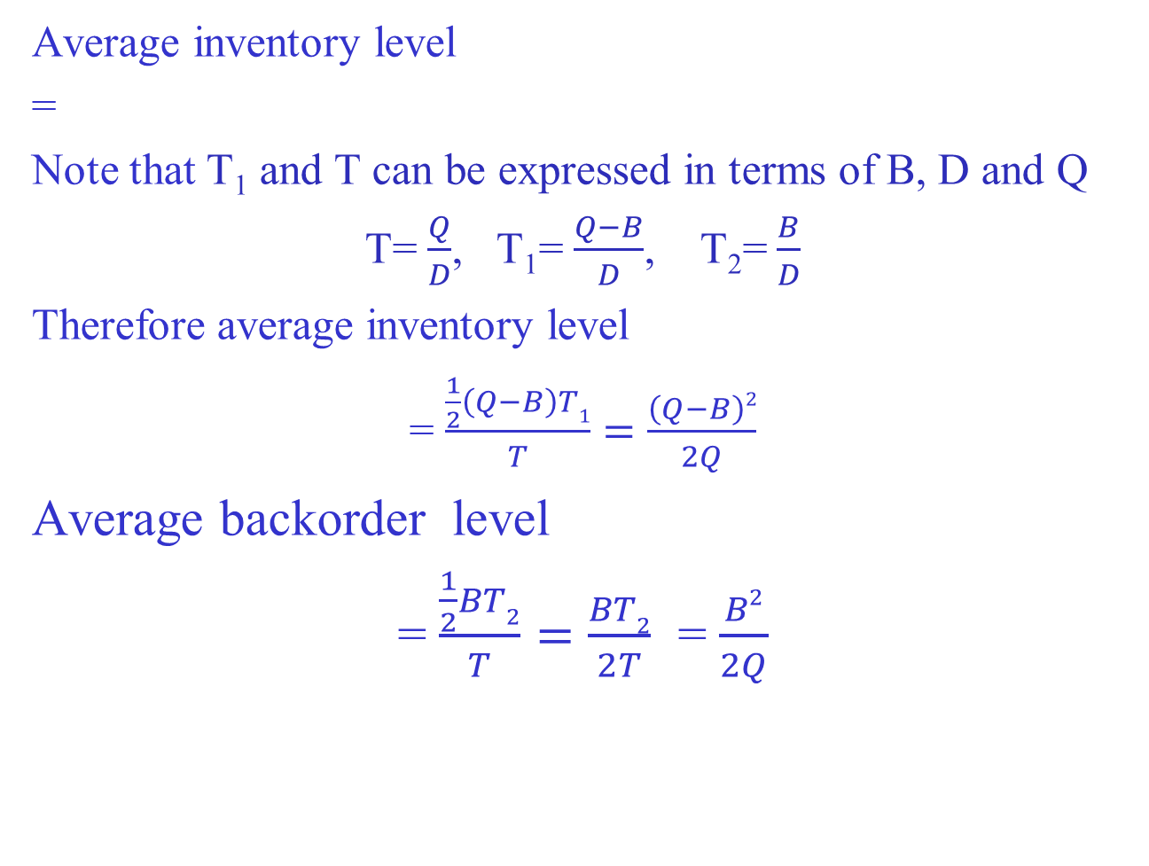

Slide 37
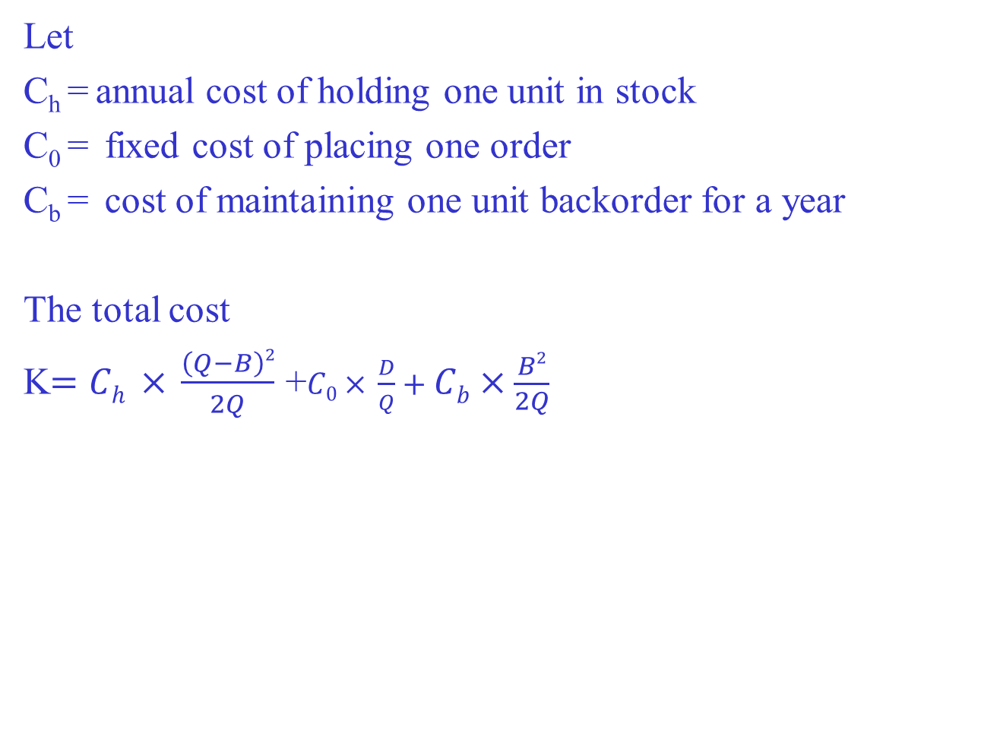

Slide 38
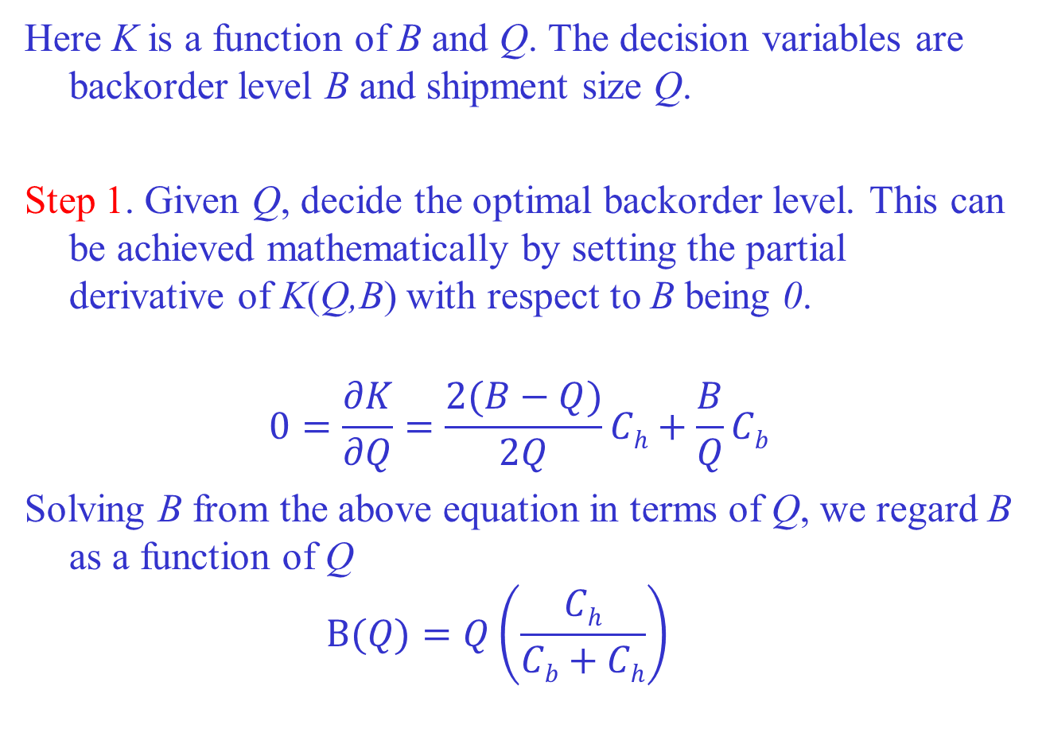

Slide 39
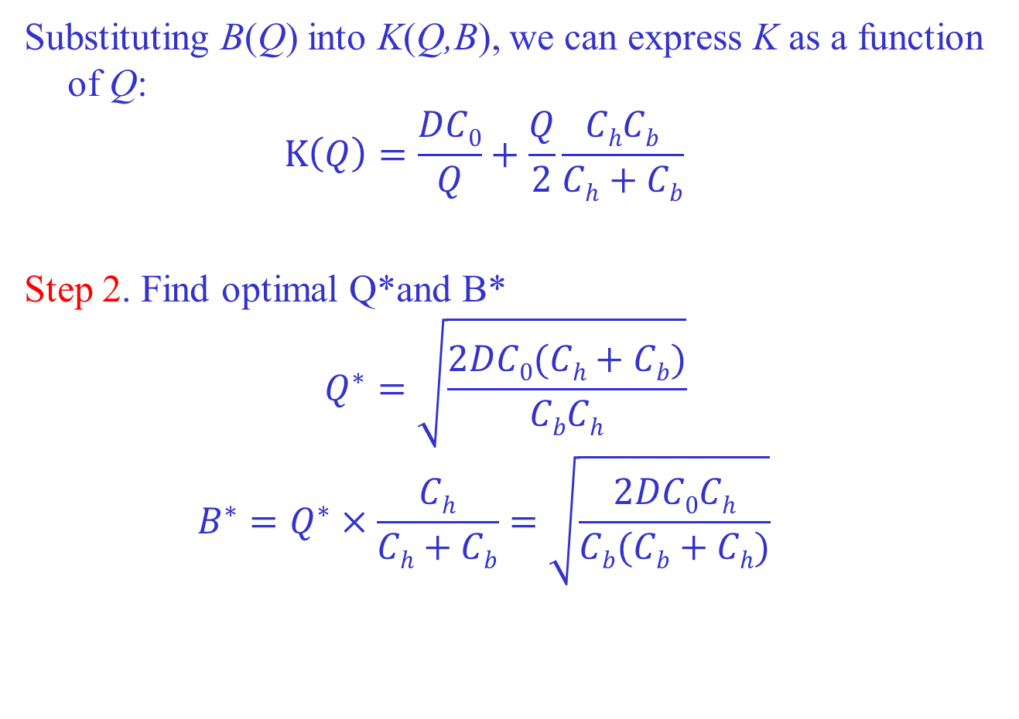

Slide 40
Example 3.1. Suppose that the Higley Radio Components Company has a product for which the assumptions of the inventory model with backorders are valid. Information obtained by the company is as follows: Demand is 2000 units per year, the component unit cost is $50. Interest rate is 20%. The order cost is fixed, that is, $25 per order. The company is considering the possibility of allowing some backorders to occur for the product. The annual backorder cost has been estimated to be $30 per unit per year. Identify Q* , B* , annual holding, ordering and backordering costs.

Slide 41
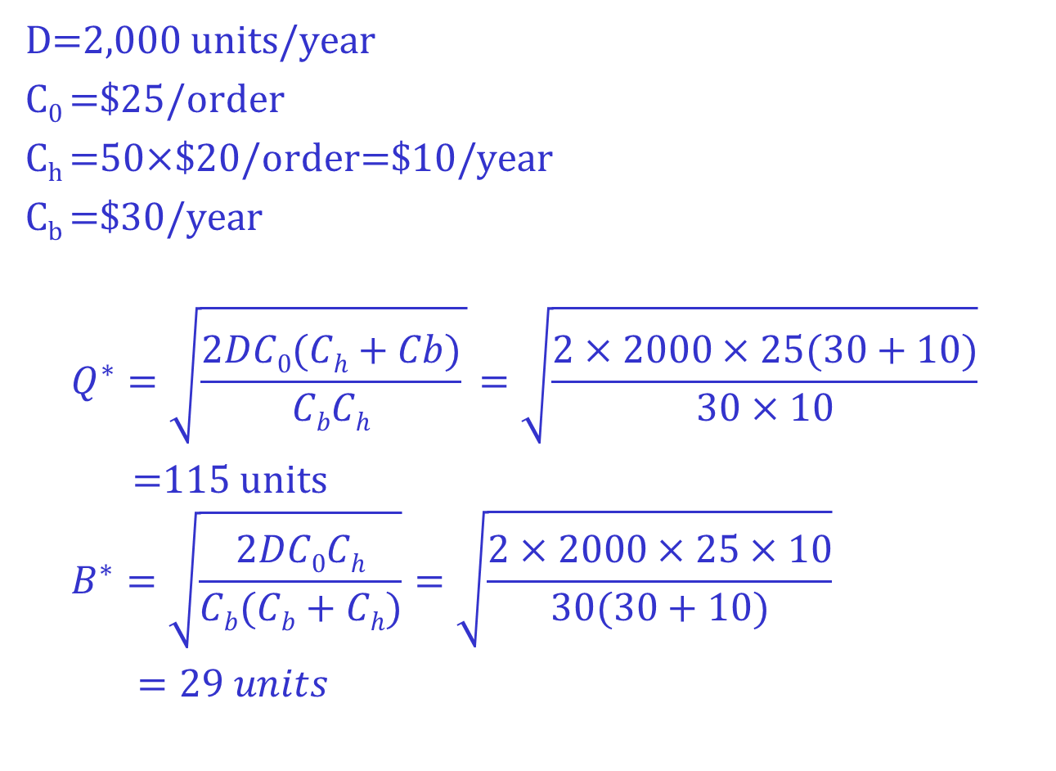

Slide 42
1.4 Quantity Discounts for EOQ Model
Quantity discounts occur in numerous situations in which suppliers provide an incentive for large order quantities by offering a lower purchase cost when items are ordered in larger quantities. There are two popular types of discounts.

Slide 43
All-Units Discounts: when the purchase quantity reaches certain level, the all unit costs are discounted.
Incremental Quantity Discounts: when the purchase quantity reaches certain level, the unit costs for those exceeding the level are discounted.

Slide 44
Example 4.1 (All unit discount).
The HW Technology has the following price schedule for certain computer components .
For orders of less than 500 units, the company charges $30 per unit;
For orders of 500 or more but fewer than 1,000 units, it charges $29 per unit;
For orders of 1,000 or more, it charges $28 per unit.

Slide 45
Total cost for all unit discount
Total purchase cost ($)
0 500 1000 order size

Slide 46
Example 4.2 (Incremental unit discount).
The HW Technology has the following price schedule for certain computer components .
For orders of less than 500 units, the company charges $30 per unit;
For orders of 500 or more but fewer than 1,000 units, it charges $29 per unit for those beyond 500 units;
For orders of 1,000 or more, it charges $28 per unit for those beyond 1000 units.

Slide 47
Total cost for incremental discount
Total purchase cost ($)
0 500 1000 order size

Slide 48
Optimal order size under total unit discount
In previous inventory models considered, the annual purchase cost was not included because it was constant and never affected by the inventory-order policy decision.
However, in the quantity discount model, the annual purchase cost depends on the order quantity and associated unit cost.

Slide 49
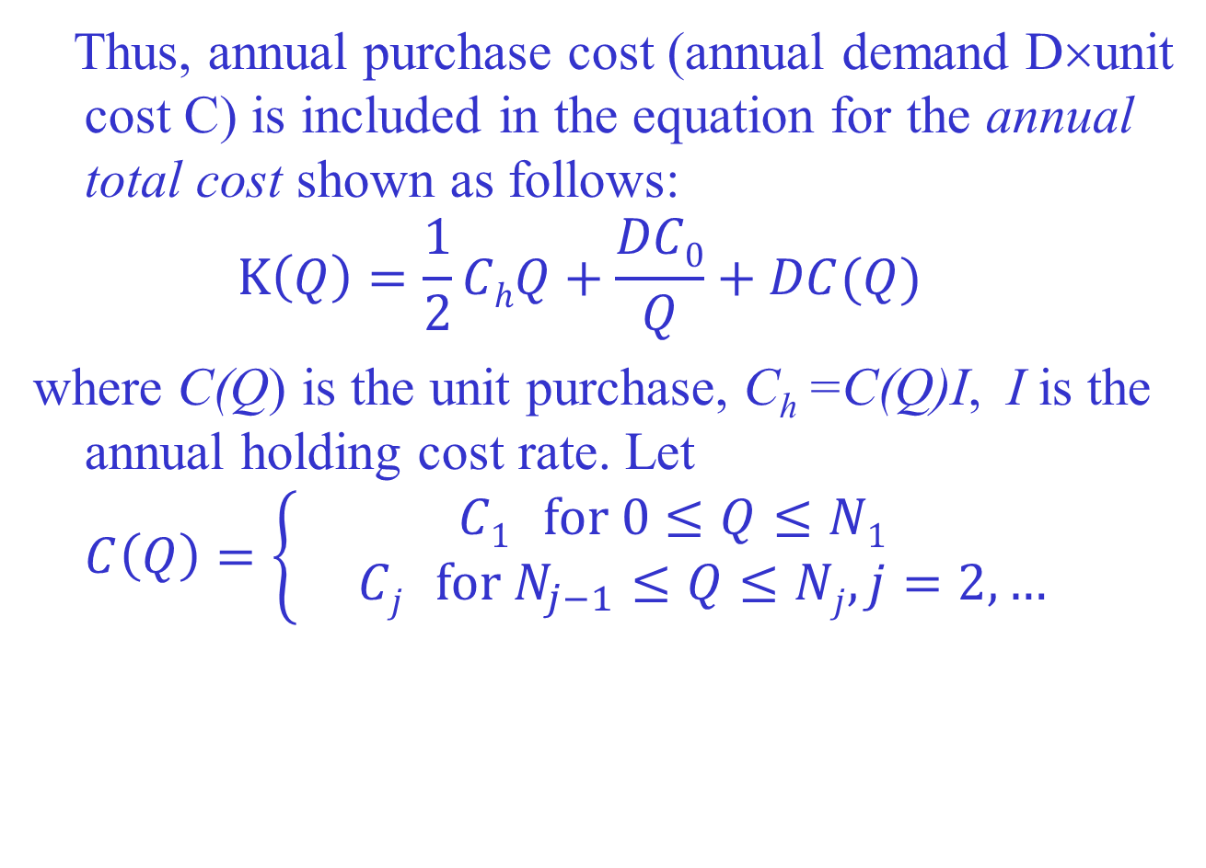

Slide 50

Therefore for $N_{j−1}≤Q≤N_{j}$
$K\left(Q\right)=\frac{1}{2}{IC}_{j}Q+\frac{DC_{0}}{Q}+DC$_{j}
for j=1,2,….

Slide 51

$K(Q)$
$N_{j−1}$ $N_{j}$

Slide 52
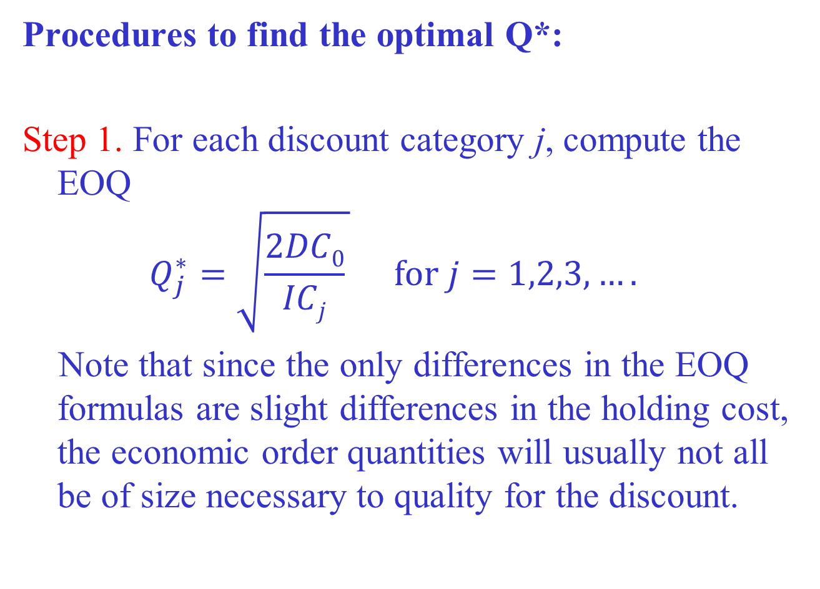

Slide 53
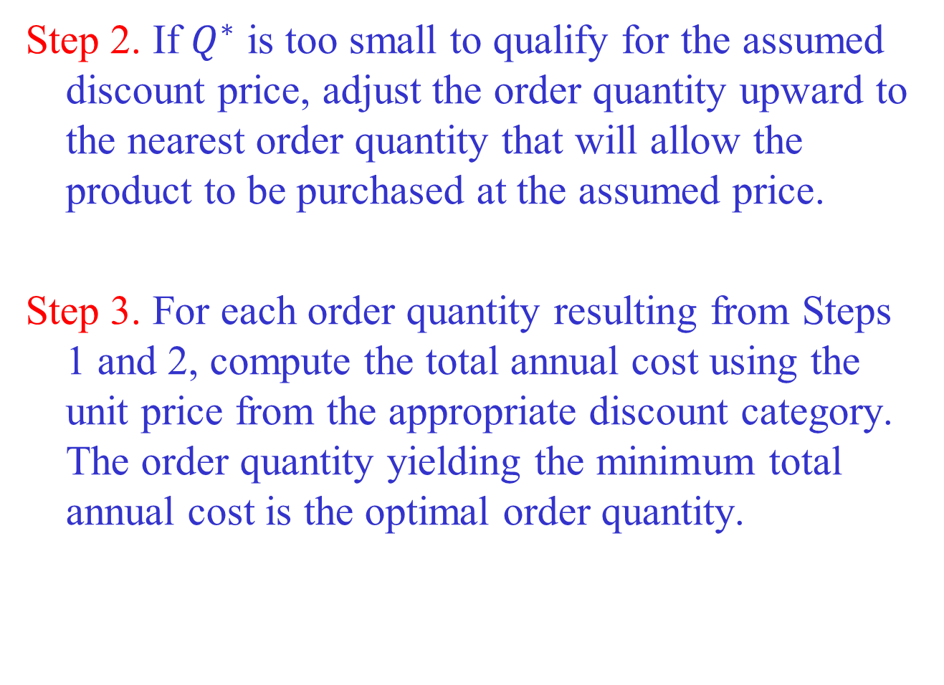

Slide 54
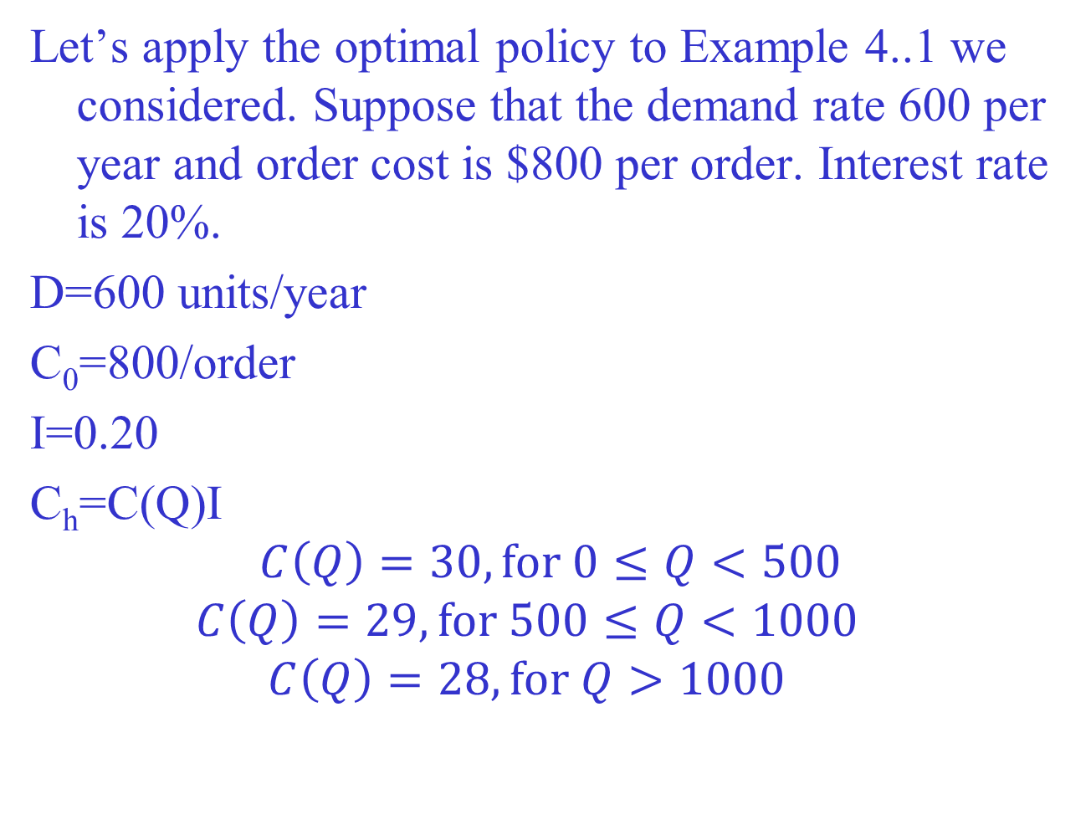

Slide 55
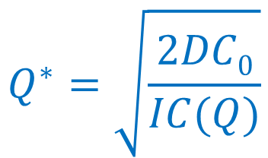
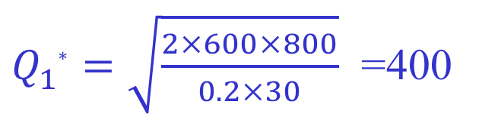
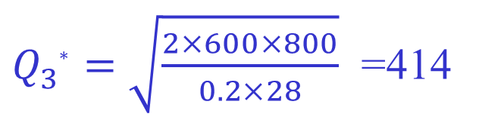
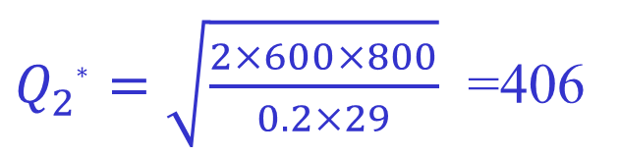
Step 1.
$Q_{1∗}^{}=\sqrt{\frac{2×600×800}{0.2×30}}$ =400
$Q_{2∗}^{}=\sqrt{\frac{2×600×800}{0.2×29}}$ =406
$Q_{3∗}^{}=\sqrt{\frac{2×600×800}{0.2×28}}$ =414

Slide 56
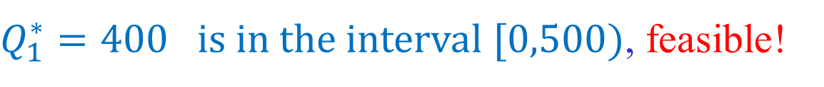
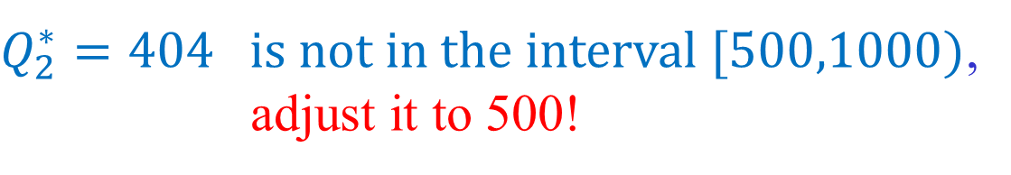
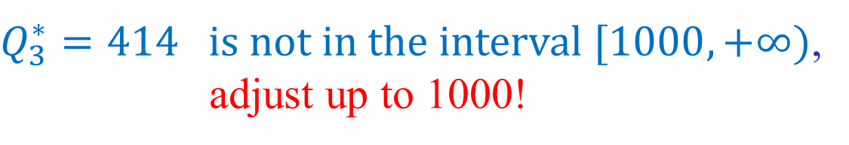
Step 2.

Slide 57
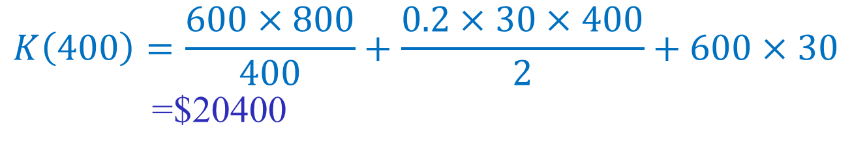
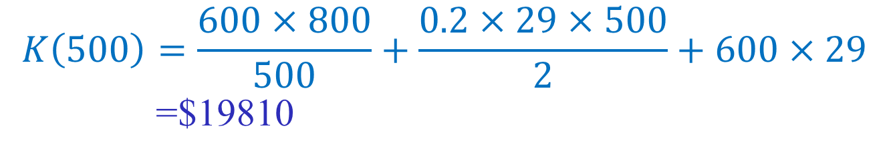
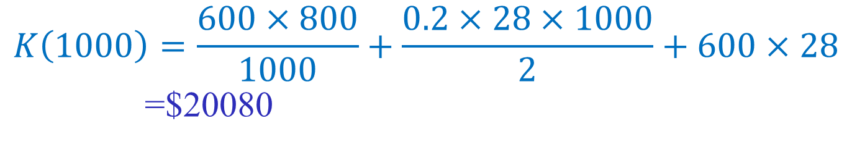
Step 3.
The optimal policy is 500!

Slide 58
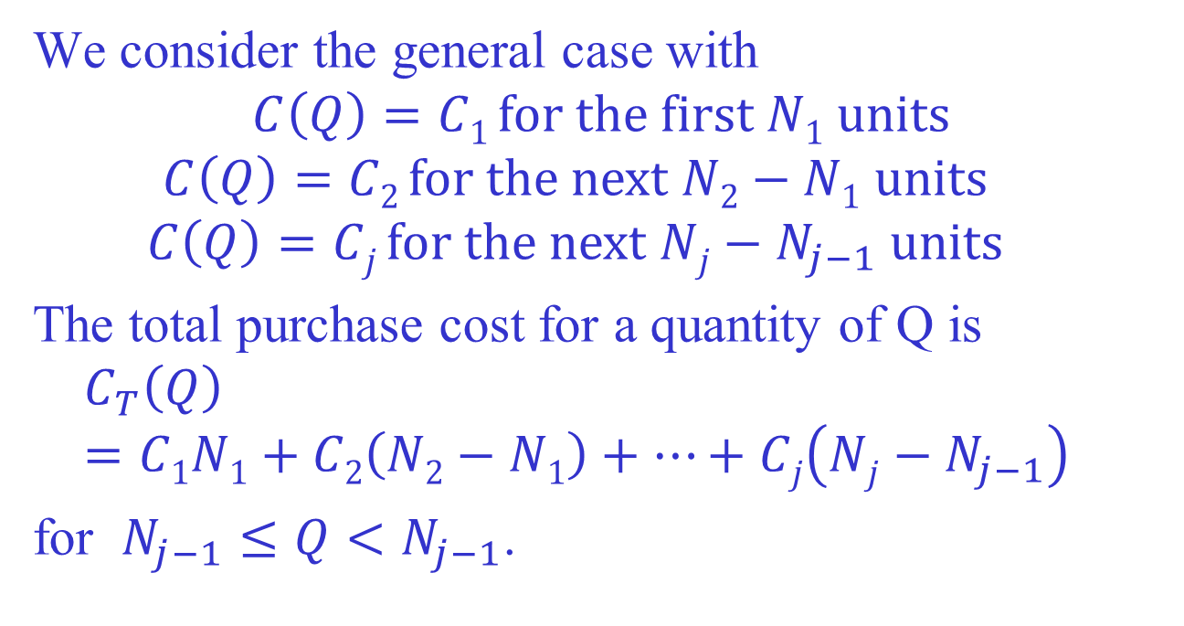
Incremental Discount Case

Slide 59
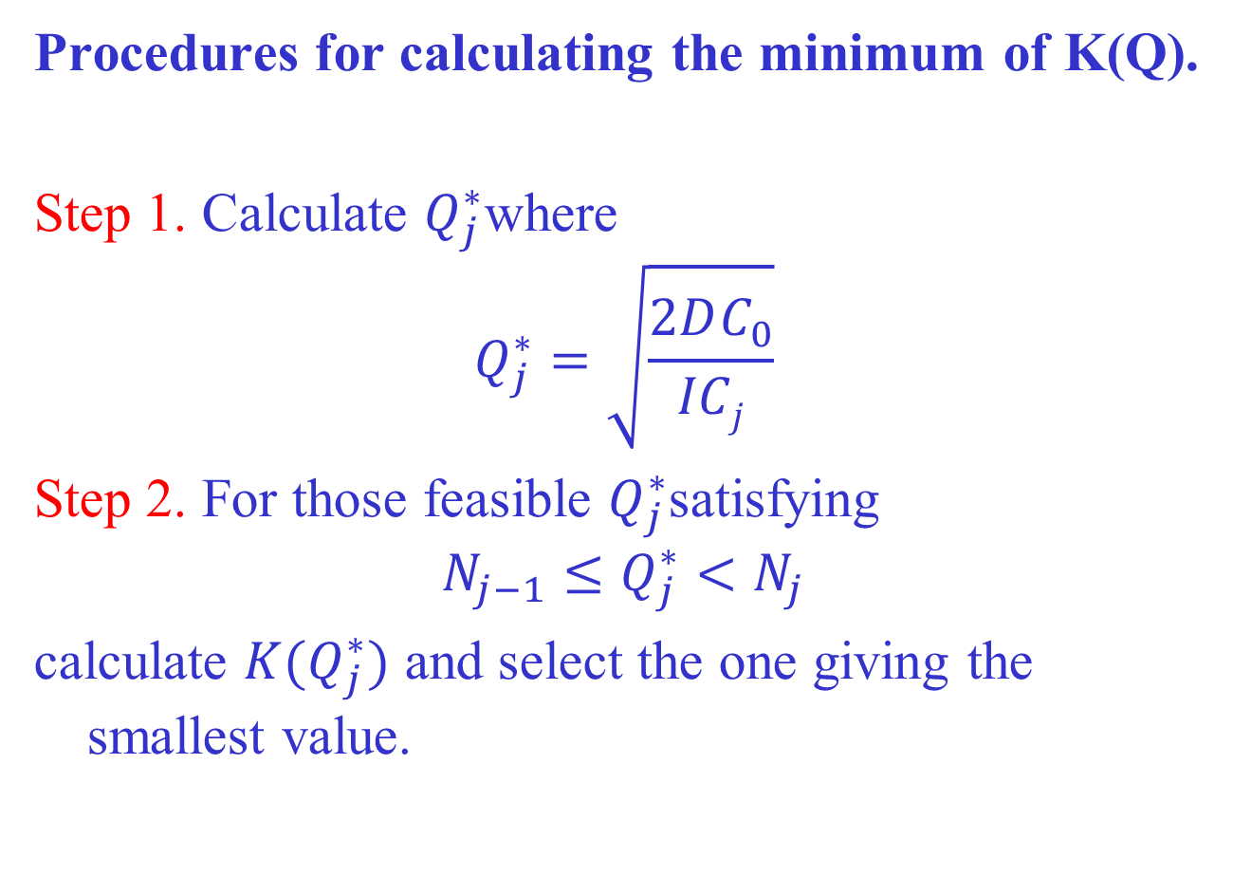

Slide 60
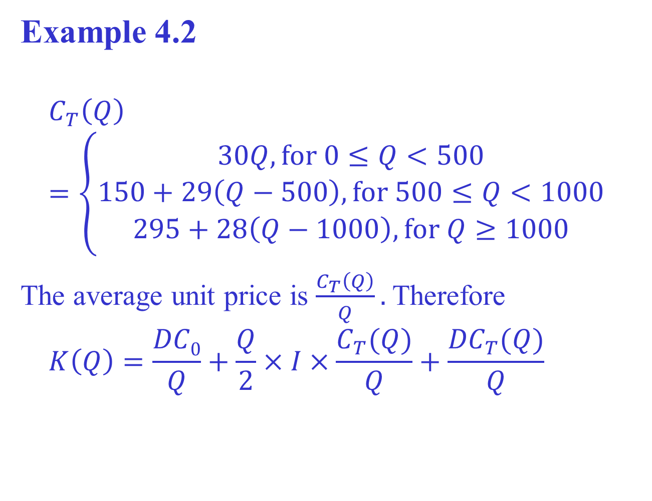

Slide 61
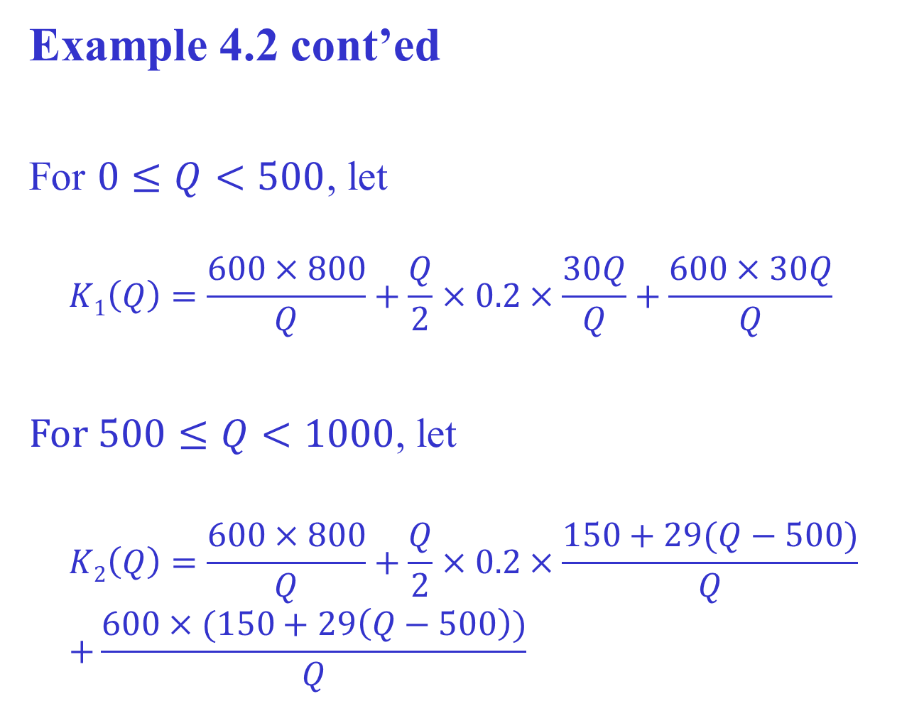

Slide 62
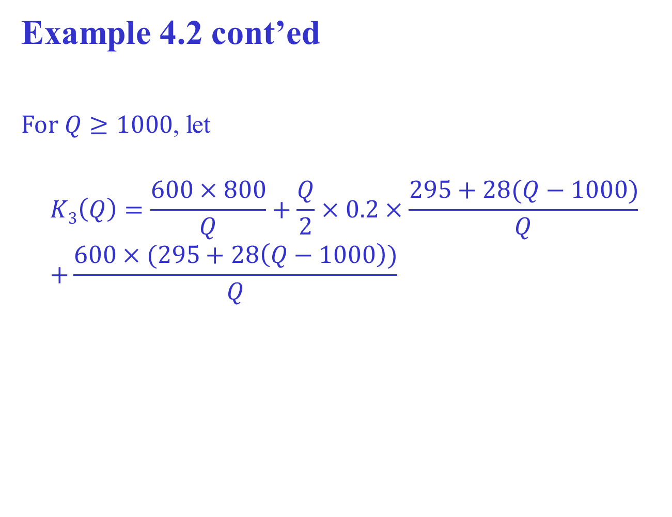

Slide 63
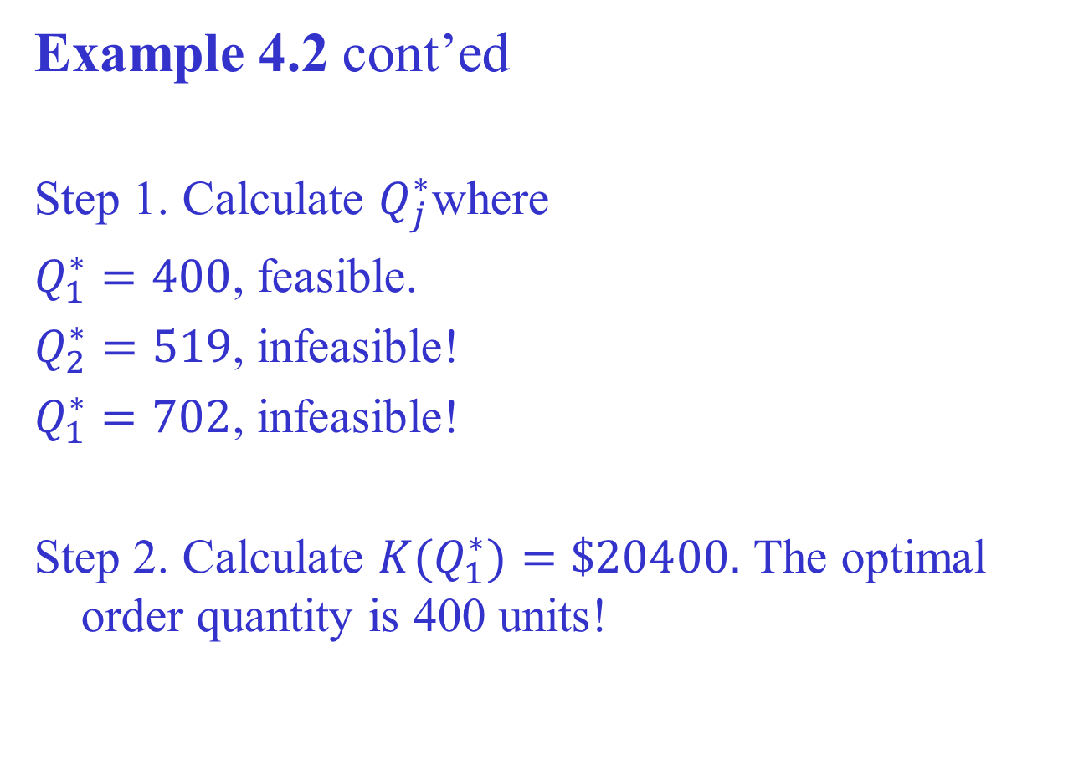

Slide 64
1.5 Production and inventory control problem
We consider an inventory control problem over a time
horizon which is divided into a fixed number of time
periods, demand at each period is stochastic and a
decision on production has to be made the beginning of
each time period before realization of demand. Inventory
may be left from one time period to the next but all items
at the end of the time period must be disposed.

Slide 65
Example (Probabilistic production planning)
Consider the following three-period inventory problem. At the beginning of each period a firm must determine how many units should be produced during the current period. During a period in which x units are produced, a production cost of c(x) is incurred, where c(0)=0, and for x>0, c(x)=3+2x. Production during each period is limited to at most 4 units. After production occurs, the period’s demand is observed. Each period’s demand is equally likely to be 1 or 2 units. After meeting the current period’s demand out of the current production and inventory, the firm’s end-of-period inventory is evaluated and a holding cost of 1 per unit is assessed. Because of limited capacity the inventory at the end of each period cannot exceed 3 units.

Slide 66
It is required that all demand be met on time. Any inventory on hand at the end of period 3 can be sold at 2 per unit. At the beginning of period 1 the firm has 1 unit of inventory. Use dynamic programming to determine a production policy that minimizes the expected net cost incurred during the three periods.

Slide 67
Let
denote the minimum expected next cost incurred
during periods t, t+1,…,3 when inventory at the
beginning of period t is i. Then
Note that
This gives

Slide 68
For t=1,2

Slide 69
Stage 3
i | x | c(x)+(i+x-3/2)-(2i+2x-3)
3 | 0 | 0 + 3/2 – 3 = -3/2*
 | 1 | 5 + 5/2 – 5 = 5/2
2 | 0 | 0 + ½ - 1 = -1/2*
 | 1 | 5 + 3/2 – 3 = 7/2
 | 2 | 7 + 5/2 – 5 = 9/2
1 | 1 | 5 + ½ - 1 = 9/2*
 | 2 | 7 + 3/2 – 3 = 11/2
 | 3 | 9 + 5/2 – 5 = 13/2
0 | 2 | 7 + 1/2 – 1 = 13/2*
 | 3 | 9 + 3/2 – 3 = 15/2
 | 4 | 11 + 5/2 – 5 = 17/2

Slide 70
Optimal values and solutions for states at stage 3

Slide 71
Stage 2
i | x | c(x)+(i+x-3/2)+1/2[f₃(i+x-1)+f₃(i+x-2)]
3 | 0 | 0 + 3/2 +2 = 7/2*
 | 1 | 5 + 5/2 – 1 = 13/2
2 | 0 | 0 + 1/2 + 11/2 = 6*
 | 1 | 5 + 3/2 +2 = 17/2
 | 2 | 7 + 5/2 – 1 = 17/2
1 | 1 | 5 + ½ + 11/2 = 11
 | 2 | 7 + 3/2 + 2 = 21/2*
 | 3 | 9 + 5/2 - 1 = 21/2*
0 | 2 | 7 + 1/2 + 11/2 = 13
 | 3 | 9 + 3/2 + 2 = 25/2*
 | 4 | 11 + 5/2 - 1 = 25/2*

Slide 72
Optimal values and solutions for states at stage 2

Slide 73
Stage 1
i | x | c(x)+(i+x-3/2)+1/2[f₂(i+x-1)+f₂(i+x-2)]
1 | 1 | 5 + ½ + 23/2 = 17
1 | 2 | 7 + 3/2 + 33/4 = 67/4
1 | 3 | 9 + 5/2 + 19/4 = 65/4*
Optimal value and solution for stage 1 and hence the whole problem

